Slide 1


Climat change through the eyes of data
Ferdinand Leube
JUN, 10th | PARIS
DAFT MAY2022

Slide 2


Business case
Climat change/climat research
A lot of controversial data about temperature increase on a global level
Is climat change in terms of increasing temperatures reflected in data?
Nevertheless, no doubt about certain regional increases
What factors could be responsible for regional increasing temperatures?

Slide 3
Plan
main methods and ideas
Investigation of my business case
Look for data related to my business case
Data collection
Data cleaning and exploratory analysis
Decide on database type
Build my ERD Model
Create database and import data
Write queries for insights

Slide 4
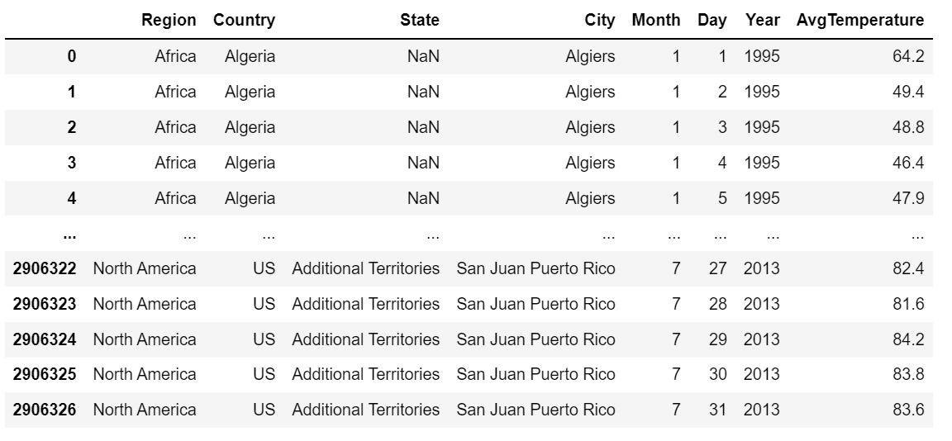
Metadata
displays daily reports of the average temperature at over 150 sites in the USA and 167 other international sites from 1995 to 2018
presents internationally comparable emissions data on greenhouse gass emissions from 1850 to 2018, includes information about 6 different economic sectors and subsectors, classifies specific greenhouse gasses released by this certain sector
long list of power plants, the country it is located in, exact location portrayed by longitude and longitude, primary fuel etc.
Notes:
.datset2 → All of the numeric data is given in Metric tons of carbon dioxide equivalent or MTCO2e.

Slide 5
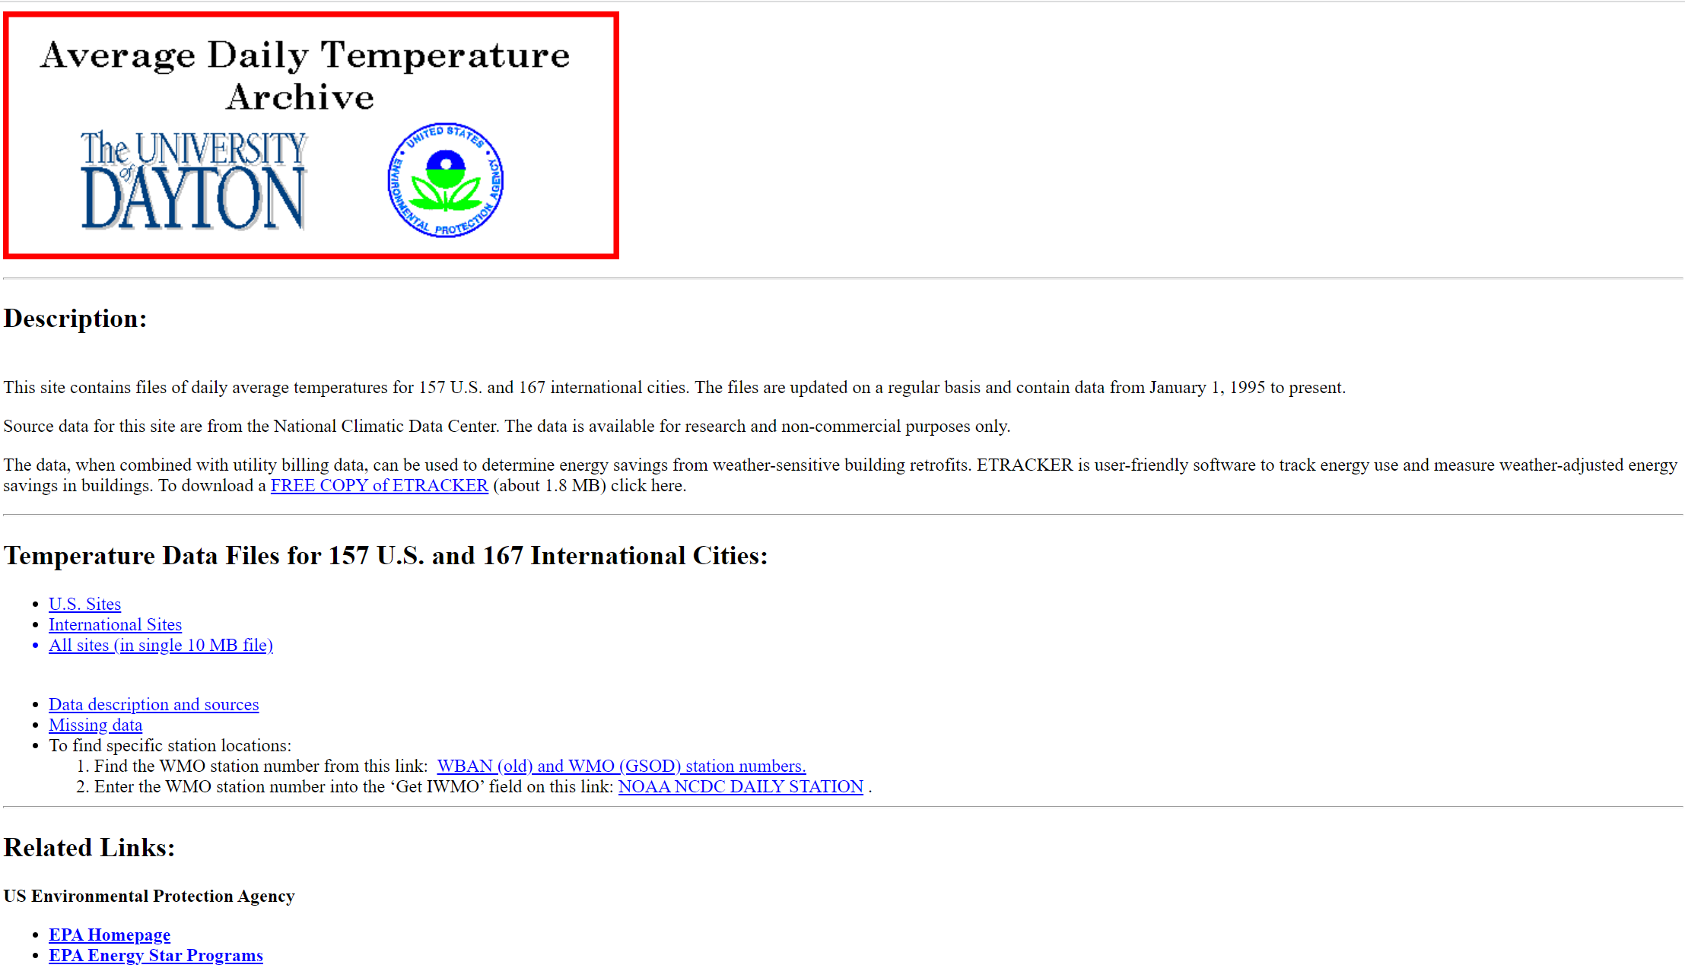
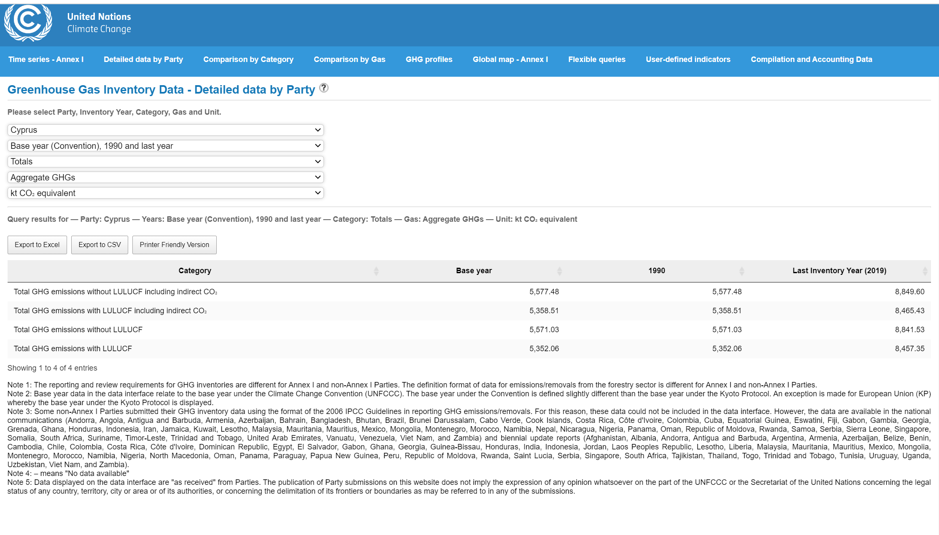
About data
Daily recorded temperature in over 300 cities over the last 20e years data
Danton University – environmental protection agency
Data about 12 different economic sectors and their greenhouse gas emissions in various countries
Climate Watch
The PRIMAP-hist national historical emissions time series (1850-2014). V. 1.1
Greenhouse Gas Inventory Data - Detailed data by Party
Data about power plants, their location capacity and primary fuel usage
WRI
Notes:
created by the University of Dayton - Environmental Protection Agency, stored in their Average Daily Temperature Archive, source university American National Climatic Data Center
first data source: Climate Watch. created 2018 by a Washington DC based institution named: World Resources Institute, Climate Watch offers open data, visualizations and analysis to help policymakers, researchers and other stakeholders gather insights on countries' climate progress.
The PRIMAP-hist national historical emissions time series (1850-2014). V. 1.1, collected and created by Gtschow Johannes, Jeffery Louise, Gieseke Robert and Gebel Ronja in 2017 as part of the potsdom institute for climat impact research
UNFCCC data: Greenhouse Gas Inventory Data - Detailed data by Party created by UNFCCC in 2017, released by the United Nations climat change institut
The World Resources Institute is a global research non-profit organization established in 1982 with funding from the MacArthur Foundation under the leadership of James Gustave Speth. WRI's activities are focused on seven areas: food, forests, water, energy, cities, climate and ocean.

Slide 6
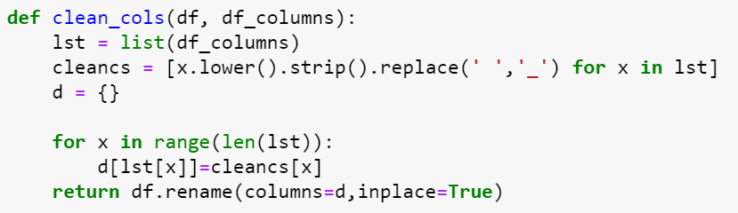
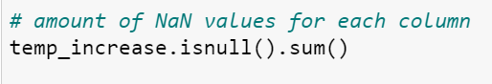
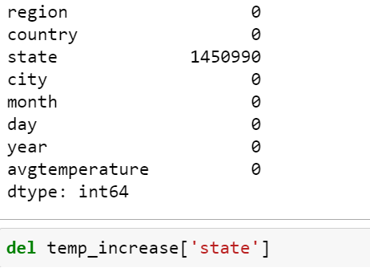
Data cleaning
Dataset with daily temperature measurements
Initialisation of the data cleaning process
.info()
checking the shape of the dataframe
looking at different types of data the columns contained
observing the column names
apply my cleaning columns function
Checking for and dealing with missing values
only ‘state’ column contained missing
Deleted column due to unnecessity for analysis
Structure the data according to my needs
grouped by columns country, city, and year
aggregated the average temperature for each
reset the index
Selecting only years and countries wanted for analysis

Slide 7
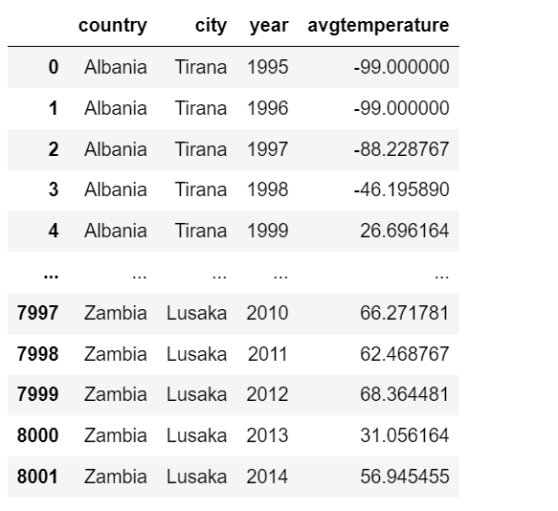
Data cleaning

Slide 8
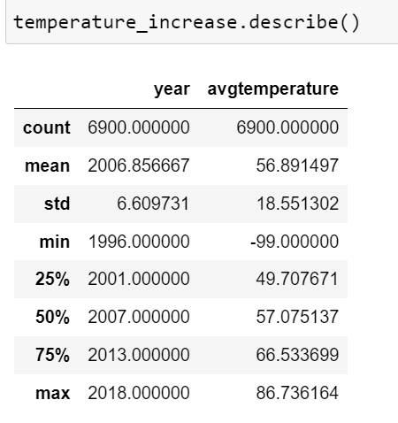
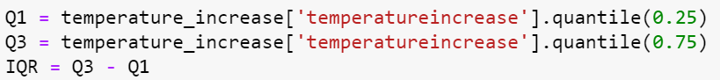
Data cleaning
Checking for unique values of columns
Performing exploratory analysis and dealing with outliers
describe function
plotting the statistical summary with the seaborn boxplot
Determined and dealt with outliers
Adding additional calculations necessary for later insights
added temperature differences by applying the pandas difference function
Corrected differences
Dealt with outlierrs
Further exploratory data anylsis
Plottting frequency distribution of temperature and development of temperature increase

Slide 9
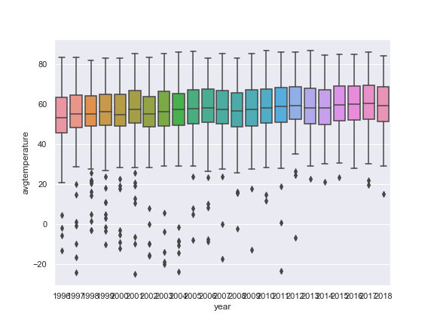
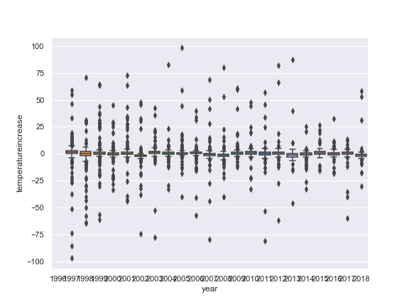
Exploratory Data analysis

Slide 10
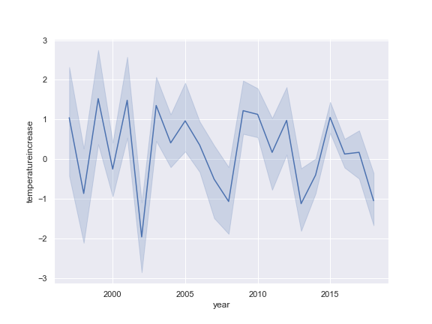
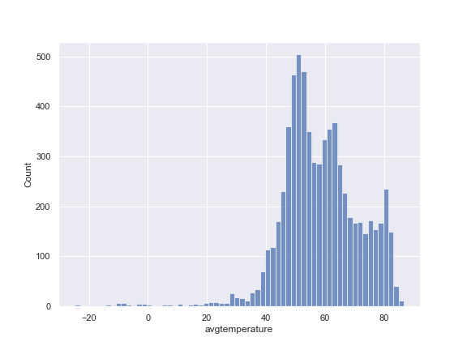
Exploratory Data analysis

Slide 11
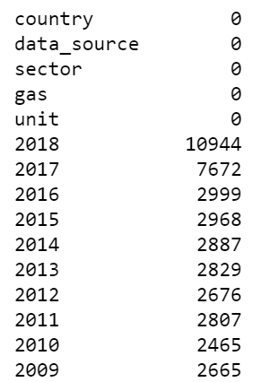
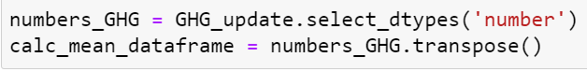
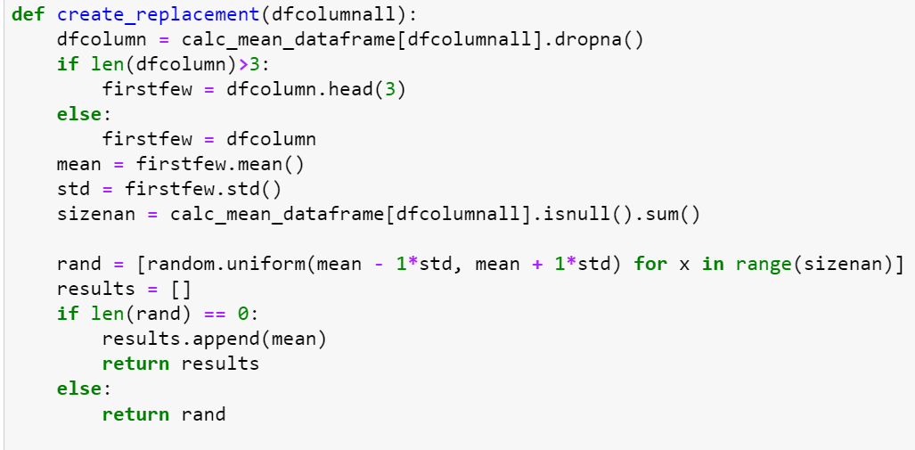
Data cleaning
Various economic sectors and their greenhouse gas emissions in different countries
Initialisation of the data cleaning process
Excluded unnecessary data about years and countries
Checking unique values of categorical value columns
Look for and dealing with missing values
selecting only columns with numerical data
transpose the data frame to calculate column wise.
apply replace function
delete all columns consisting only of missing values
concatenate the numeric data frame back with data frame consisting of categorical values
transpose it back to original format.

Slide 12
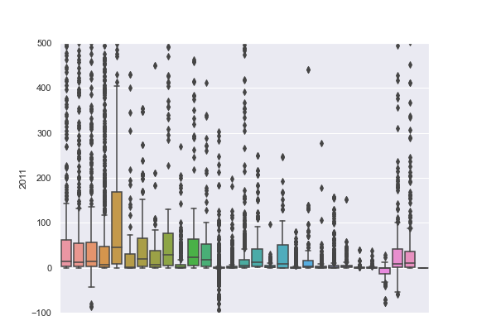
Data cleaning/Exploratory analysis
Start exploratory analysis
Create boxplot for economic sectors for every year
Determine outliers
Drop values beneath zero
Kept other boxplot defined outliers

Slide 13
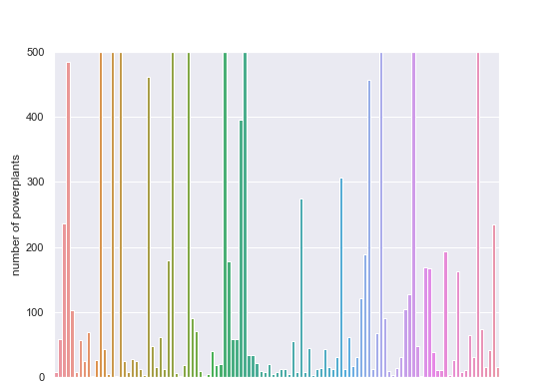
Data cleaning/Exploratory data analysis
Data about power plants
Data cleaning initialization
Dealing with missing values
Only columns unnecessary for later analysis contained missing values
Drop of those columns
Checking for unqiue values of columns
Exploratory data analysis
frequency distribution of amount of power plants for each country
frequency distribution of power plants per primary fuel.
statistical summary of the frequency distribution for primary fuels using a box plot

Slide 14
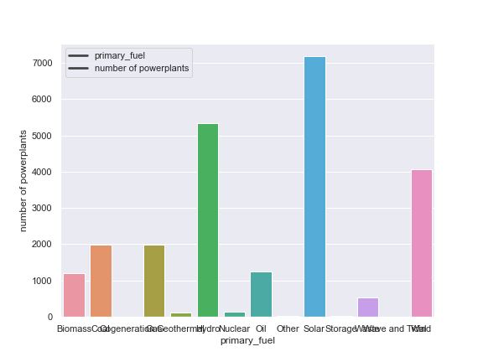
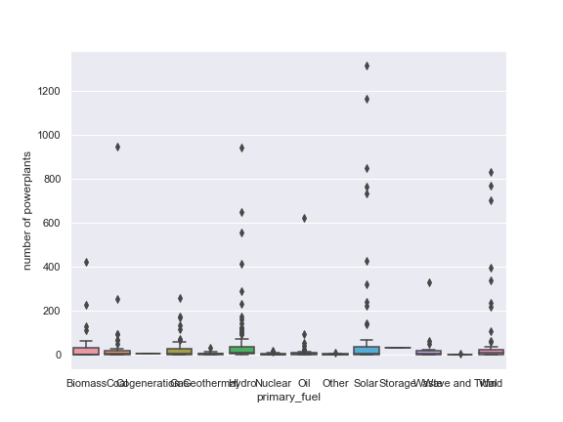
Exploratory Data analysis
Notes:
Solar hydro and

Slide 15
Choose a data base
SQL | NoSQL
can work with smaller amounts of data | can work with big amount of data
supports transactions on cell level | does not support atomic transactions
slower querying, but faster updating | slower update, faster querying
Structured data | unstructured or semi structured data
OOP unfriendly (object oriented programming) | OOP friendly

Slide 16

Choose a data base
I decided to use a SQL database
allows me to use my cleaned and converted data frames
perform queries on a small level.
link the different tables with each on their relational basis.
do not care about object-oriented programming
writing longer queries is acceptable
The most important factor is to be able to work with the output of my data cleaning process: structured data
The relational database I will use is MySQL
Notes:
Centralized: stores data at a centralized database system + access from different locations + authentication process Distributed: distributed among different database systems + database systems are connected via communication links Relational: based on the relational data model + which stores data in the form of a table (row +column) + uses SQL for storing, manipulating Object-oriented: uses the object-based data model approach for storing data Why SQL: ability to store the data collected + ability to create queries and retrieve information + ability to create relations or not

Slide 17
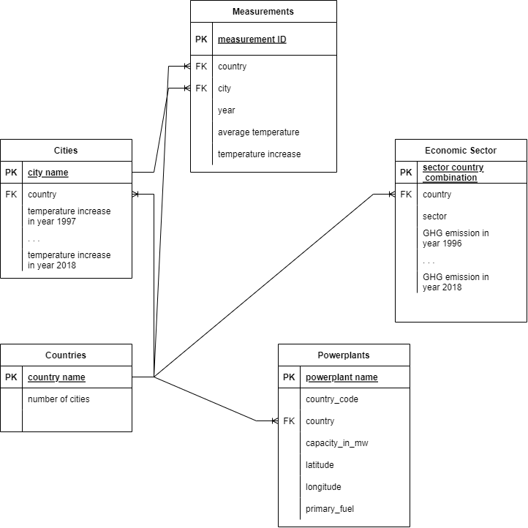
ERD
measurement entity: unique measurement ID (primary key), location, observation time, results for average temperature and temperature increase.
country entity: data with all countries and number of cities
City entity: city name (primary key), country, average temperature in years 1996 through 2018 and their average temperature increase
economic sector entity: sector-country combination (primary key), greenhouse emission for certain sector in a certain country from 1996 to 2018
powerplants entity: power plant name (primary key), country, primary fuel type, etc.
All the entities have country as their foreign key referencing the country entity. This relationship between all entities will later allow me to perform various queries on correlations between the data of the different entities.

Slide 18
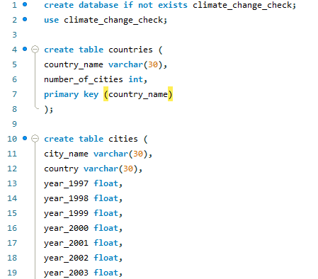
Database creation

Slide 19
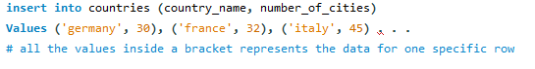
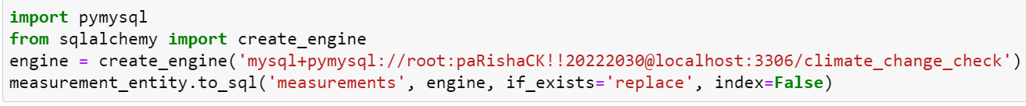
Data importation into Database
3 different ways to import data into tables
Method above, outdated and time consuming
table data import wizard method
Two tables too large
imported the pymysql and sqlalchemy library to set up a connection between MySQL local server and my jupyter notebook and import the data into my database with created engine.

Slide 20
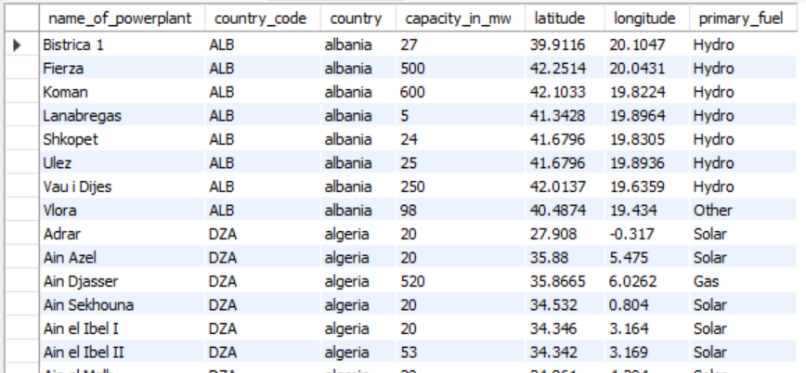
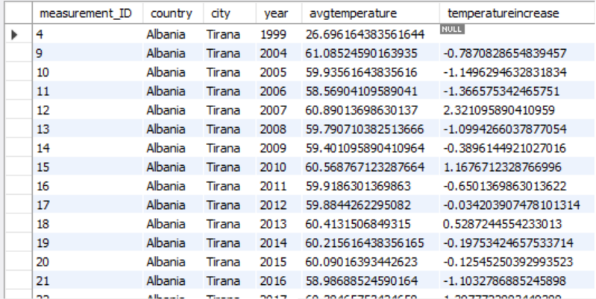
Tables

Slide 21
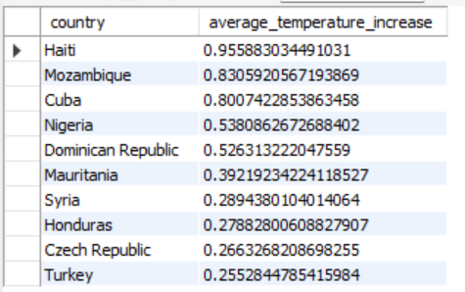
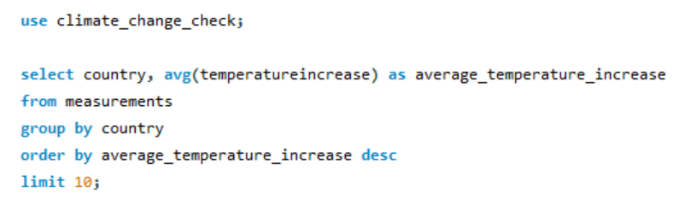
Insight queries
checking the baseline question of my business case: does the data reflect increasing temperatures over the last couple of years and which countries had the highest average temperature increase
used the measurement table, grouped countries, aggregated average temperature increase for each
Displayed top 10 results

Slide 22
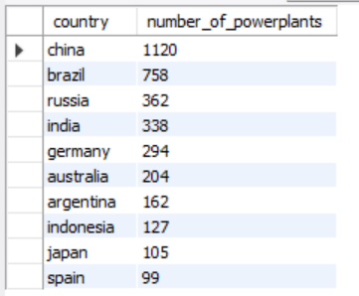
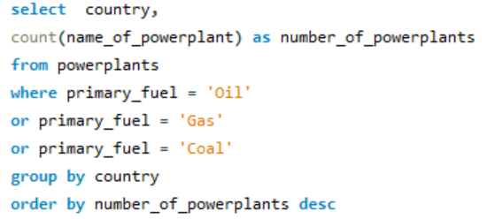
Insight queries
Checking for correlation between temperature increases and my two factors
started with power plants table
grouping by countries, aggregating the number of power plants whose primary fuel type is carbon based
such as e.g. natural oil or coal.
On the right top 10 countries with the highest number of such power plants.

Slide 23
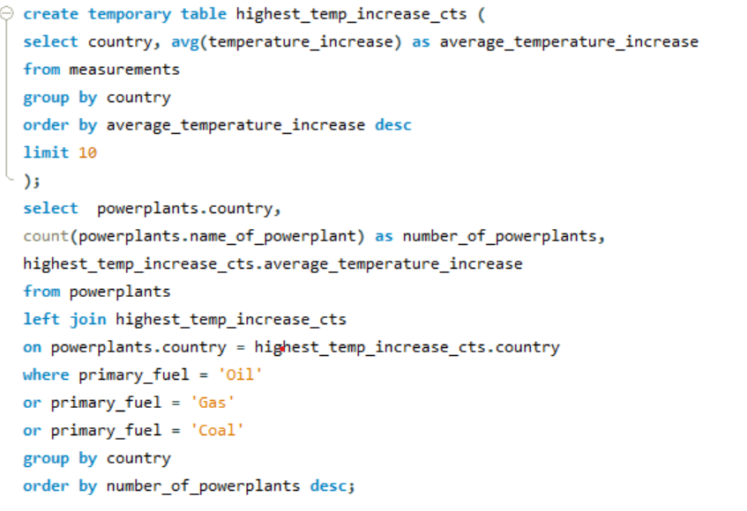
Insight queries
Using a left join, aggregated the results of this query and the previous query
Check if those countries are among countries which use carbon based fuels powerplants.
Results:
Seven are among those countries having carbon based using powerplants
Turkey and check republic among top 25

Slide 24
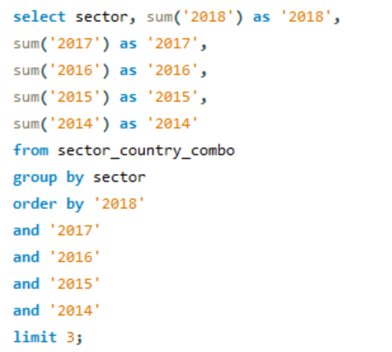
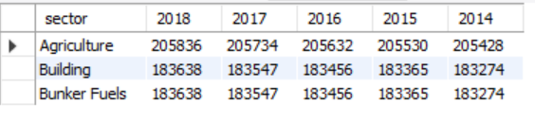
Insight queries
Check my second factor: is there a correlation between how dominant economic sectors with high greenhouse gas emissions are represented in countries and their temperature increase
Which economic sectors have the highest greenhouse gas emissions?
Using the sector country combo table, grouping by sector summing the values for every sector in the last 5 years

Slide 25
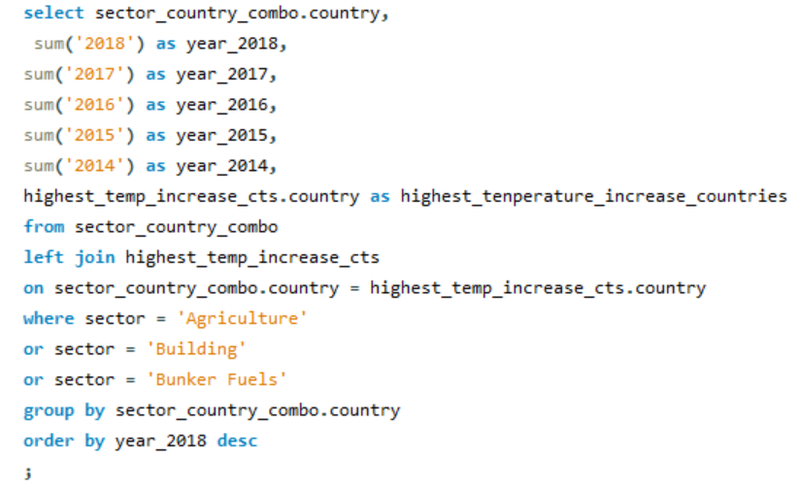
Insight queries
Using same table, grouping by country, summing all of the values that have been collected for the emissions of those 3 sectors shown before for the last five years, ordering values descendingly.
Check: are top ten temperature-increasing countries are among those having data on these 3 sectors?
Joined a temporary table displaying those top ten countries
Results:
All top 10 countries among the those we with data on sectors with high GHG emission
5 of them being among the top 40

Slide 26
Conclusions
Against expectations, exploratory analysis has revealed there has not been a general temperature increase over the past years
rather a form of up and down cycle with temperatures falling and rising every few years
on a country level there has been temperature increases, reaching up to 1 degree per year on average
Regarding the given data, conclude that there are correlations between the factors defined in my business case and the increasing temperatures of the countries with the highest temperature increases
keep in mind: these conclusions are all based on the given data sets used only
Notes:
For example the fact that over 150 cities recorded in the data were based in the US might have affected the output of my analysis regarding the general temperature increase over the years. If I would have had more time, further steps could have been taking into account more data measurements about different countries so there would be an equal amount of data for each country proportionally.

Slide 27
Climat change through the eyes of data
Ferdinand, Leube
Questions?

